Slide 1
Start
Can you unscramble the words and guess the topic of today's lesson?
Pyrography
Chappy
Coppy
cryptograph
atrophy

Slide 2
Cryptography

Slide 3
Learning Objectives
What is Cryptography ?
Why Cryptography is important?
Cryptography Components
Activity
Type of Cryptography
How Symmetric & Asymmetric Encryption Works
Cryptography Protocols

Slide 4
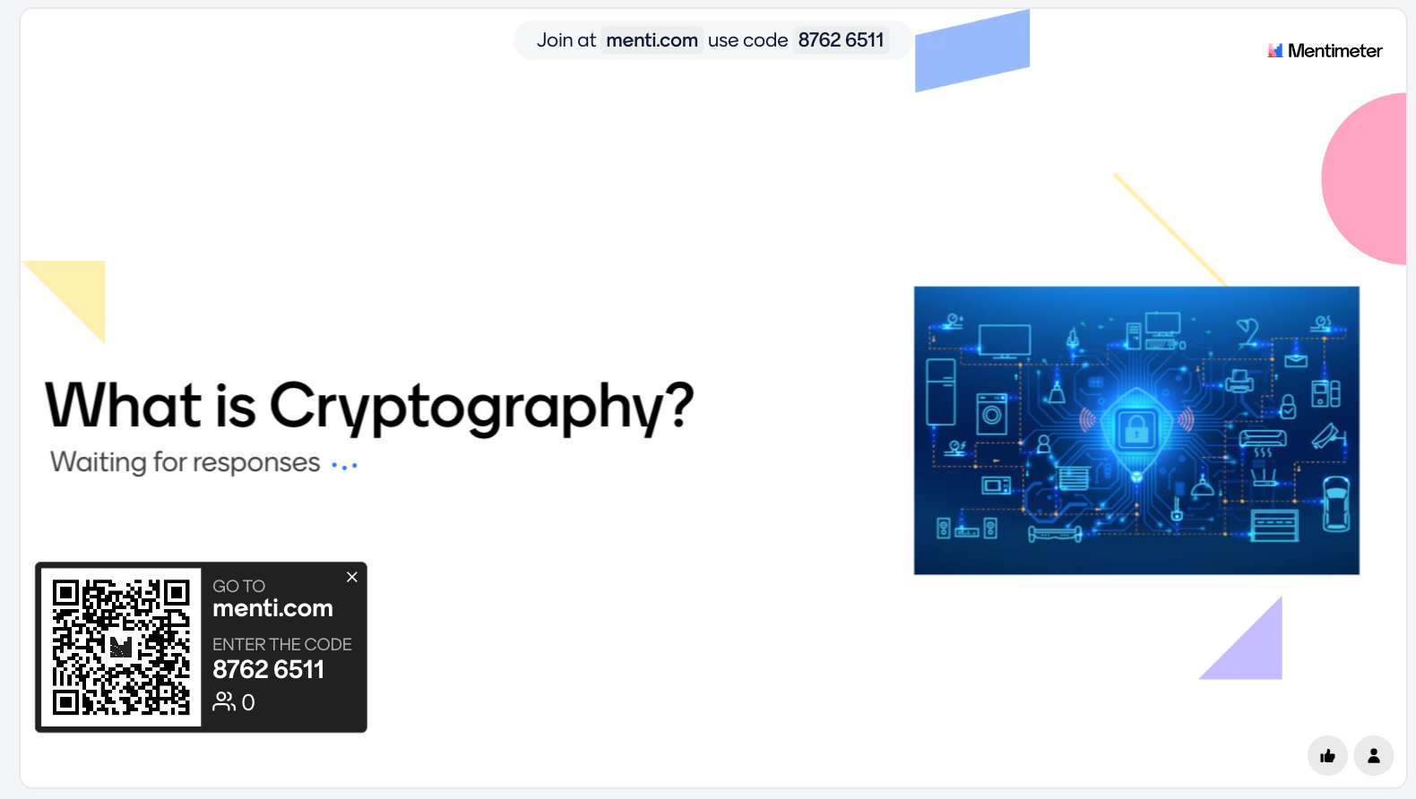
What is Cryptography ?
Notes:
Encryption
Decryption
Security
Confidentiality
Algorithms
Keys
Ciphers
Privacy
Cryptanalysis
Protection
Information
Communication
Confidential
Authentication
Integrity
Cryptosystem
Key exchange

Slide 5
What is Cryptography ?
Cryptography is practice of securing communication and information through the use of mathematical techniques and algorithms.
Cryptography is a way to keep information secret or secure by using codes and techniques to protect it from unauthorized access.
Its primary goal is to protect the confidentiality, integrity
Notes:
Communication is the process of exchanging information
set of rules designed to perform a specific task or solve a particular problem.

Slide 6
Why Cryptography is important?
Data Security: It helps protect sensitive information like (passwords and credit card numbers etc ) form unauthorised access.
Privacy: Cryptography ensures that your personal messages and communications remain private, preventing eavesdropping.
Integrity: Cryptography ensure that information is accurate and complete.
Secure Access Control: implement secure access control mechanisms, such as password hashing and multi-factor authentication

Slide 7
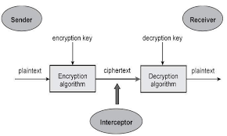
Cryptography Components
Sender: This is the creator of the message, who wants to send information securely.

Slide 8
Cryptography Components
Plaintext: This is the original message that the sender wants to encrypt. It is in a readable format that anyone can understand.

Slide 9
Cryptography Components
Encryption Key: This is piece of information used in encryption algorithms to transform plaintext (unencrypted data) into ciphertext (encrypted data) .

Slide 10
Cryptography Components
Encryption Algorithm: This is the method or mathematical function the sender uses to transform the plaintext into ciphertext using the encryption key. like AES (Advanced Encryption Standard) or RSA (Rivest–Shamir–Adleman).

Slide 11
Cryptography Components
Ciphertext: This is the encrypted version of the message. It should appear as a random string of characters, unreadable to anyone who doesn't have the decryption key.

Slide 12
Cryptography Components
Interceptor: Sometimes referred to as an attacker or eavesdropper. This is an unauthorised person that attempts to capture the encrypted message.
Notes:
The goal of encryption is to ensure that even if the interceptor captures the ciphertext, they should not be able to decrypt it back into plaintext without the key.

Slide 13
Cryptography Components
Decryption Algorithm: This is the method the receiver uses to convert the ciphertext back into plaintext. Ideally, it should be the inverse function of the encryption algorithm, requiring the decryption key.

Slide 14
Cryptography Components
Decryption Key: This is the piece of information needed to decrypt the ciphertext.

Slide 15
Cryptography Components
Receiver: This is the person receive the message, who uses the decryption key and algorithm to convert the ciphertext back into plaintext.

Slide 16

Activity
Suggest what sentence or word from the drawing

Slide 17
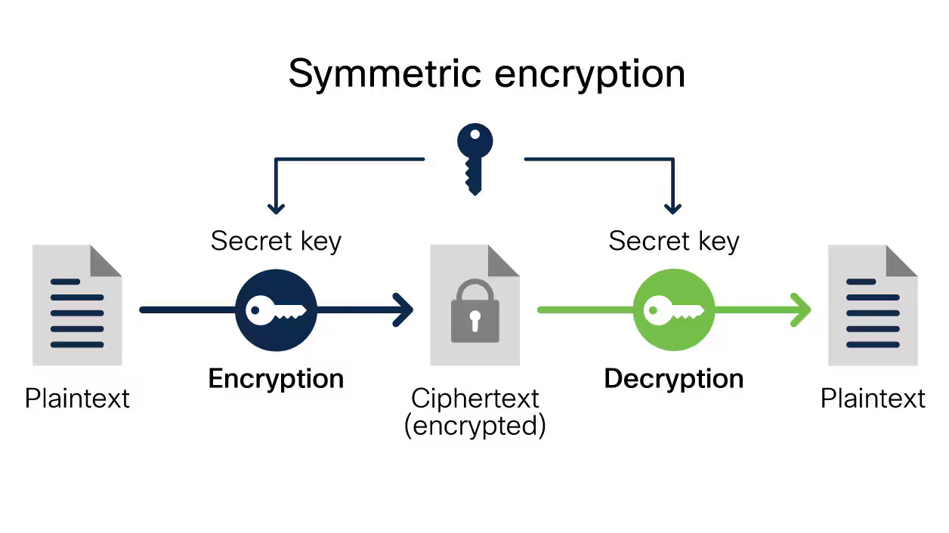
Type of Cryptography
Symmetric Key Cryptography (Secret Key Cryptography): In this type of cryptography, the same secret key is used for both encryption and decryption.

Slide 18
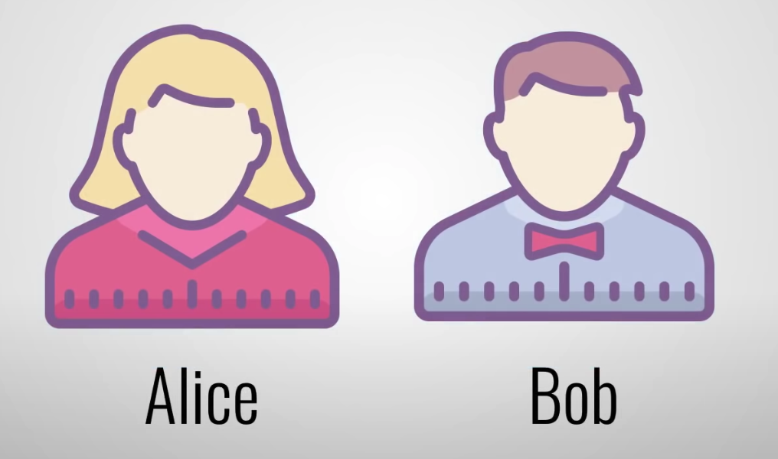

How Symmetric Encryption Works
Encryption:
Step 1: Alice wants to securely send a message to Bob. They both share a secret key.

Slide 19
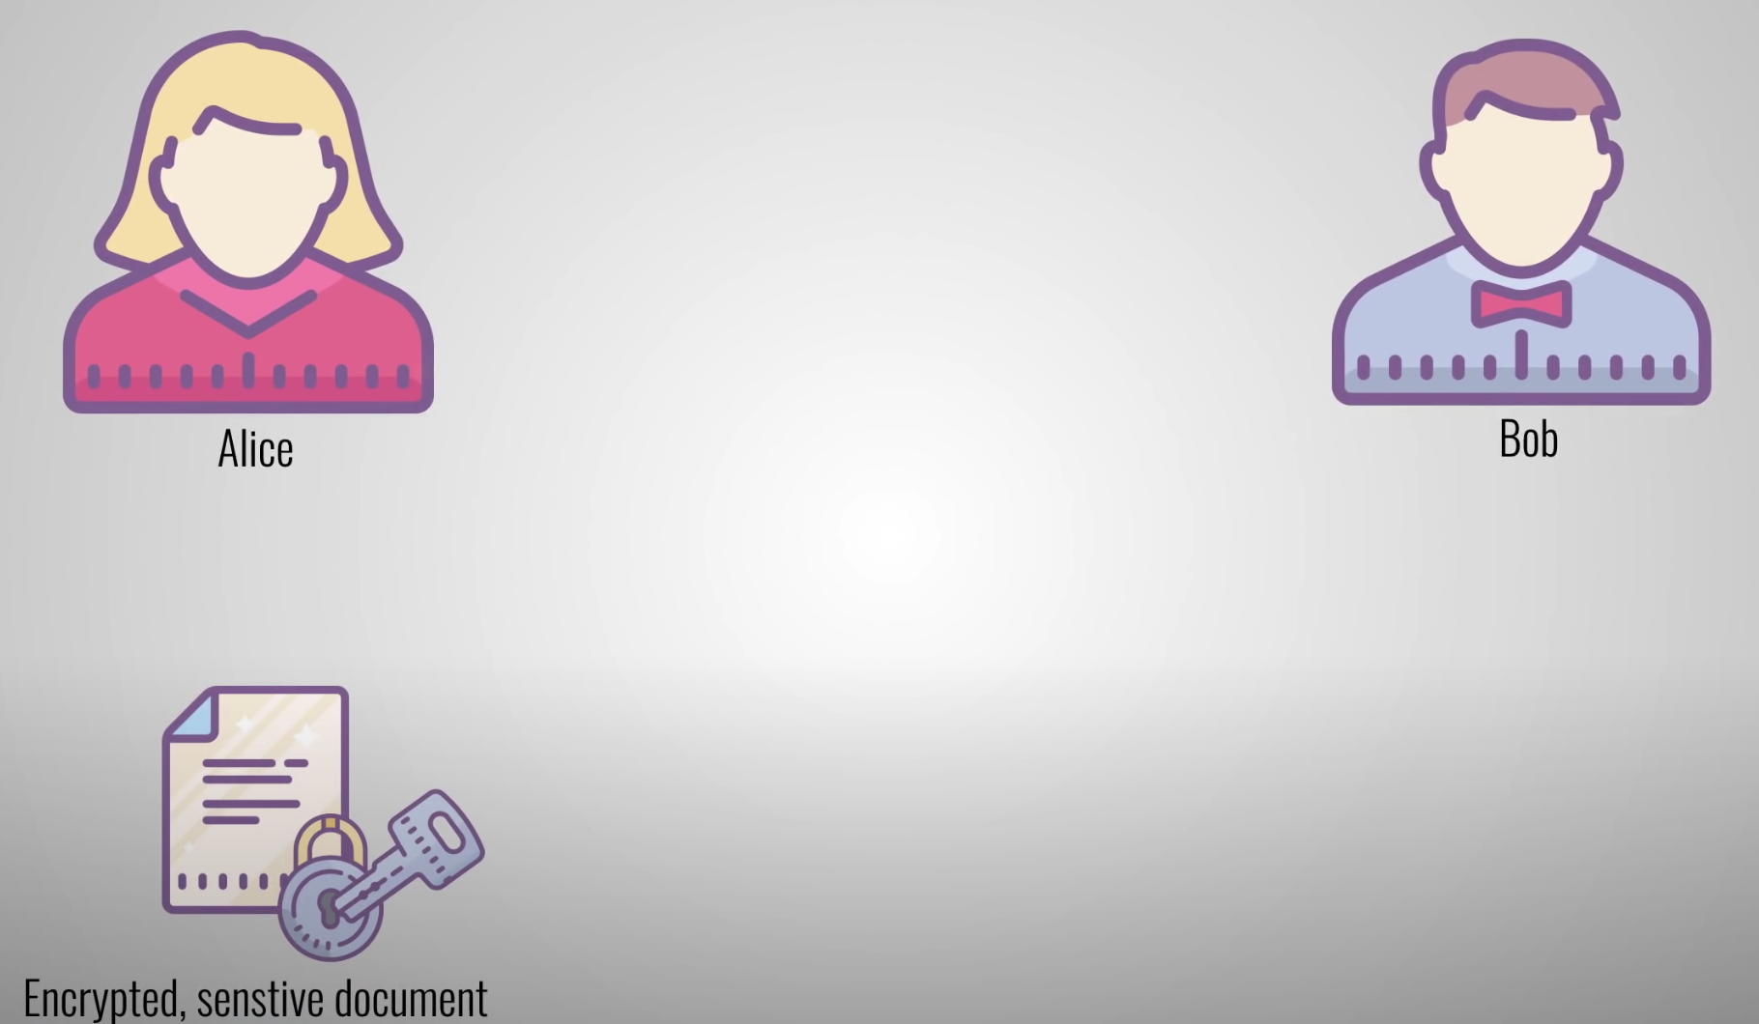
How Symmetric Encryption Works
Encryption:
Step 2: The Alice uses the shared secret key to encrypt the plaintext message.

Slide 20

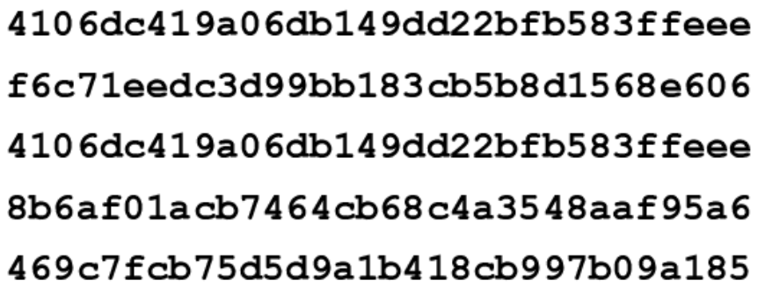
How Symmetric Encryption Works
Encryption:
Step 3: The encryption process transforms the plaintext into ciphertext, which appears as a random jumble of characters.

Slide 21



How Symmetric Encryption Works
Transmission:
Step 4: Alice transmits the ciphertext over an insecure communication channel (e.g., the internet).

Slide 22
How Symmetric Encryption Works
Transmission:
Step 4: Even if an eavesdropper intercepts the ciphertext and the public key, they cannot easily decrypt the message without the private key.

Slide 23

How Symmetric Encryption Works
Decryption:
Step 5: Bob receive the ciphertext. also has the secret key

Slide 24

How Symmetric Encryption Works
Decryption:
Step 7: The decryption process transforms the ciphertext back into the original plaintext message.

Slide 25

How Symmetric Encryption Works
Let's do it in real life.

Slide 26
Common symmetric key algorithms
Advanced Encryption Standard (AES): Widely used and highly secure symmetric encryption algorithm with key lengths of 128, 192, or 256 bits.
Data Encryption Standard (DES): An older symmetric encryption algorithm that is less secure and has largely been replaced by AES.
Triple Data Encryption Algorithm (3DES): An enhancement of DES that applies the DES algorithm three times in succession with different keys for improved security.

Slide 27
Type of Cryptography
Asymmetric Key Cryptography (Public Key Cryptography): Asymmetric cryptography uses a pair of keys, a public key for encryption and a private key for decryption

Slide 28
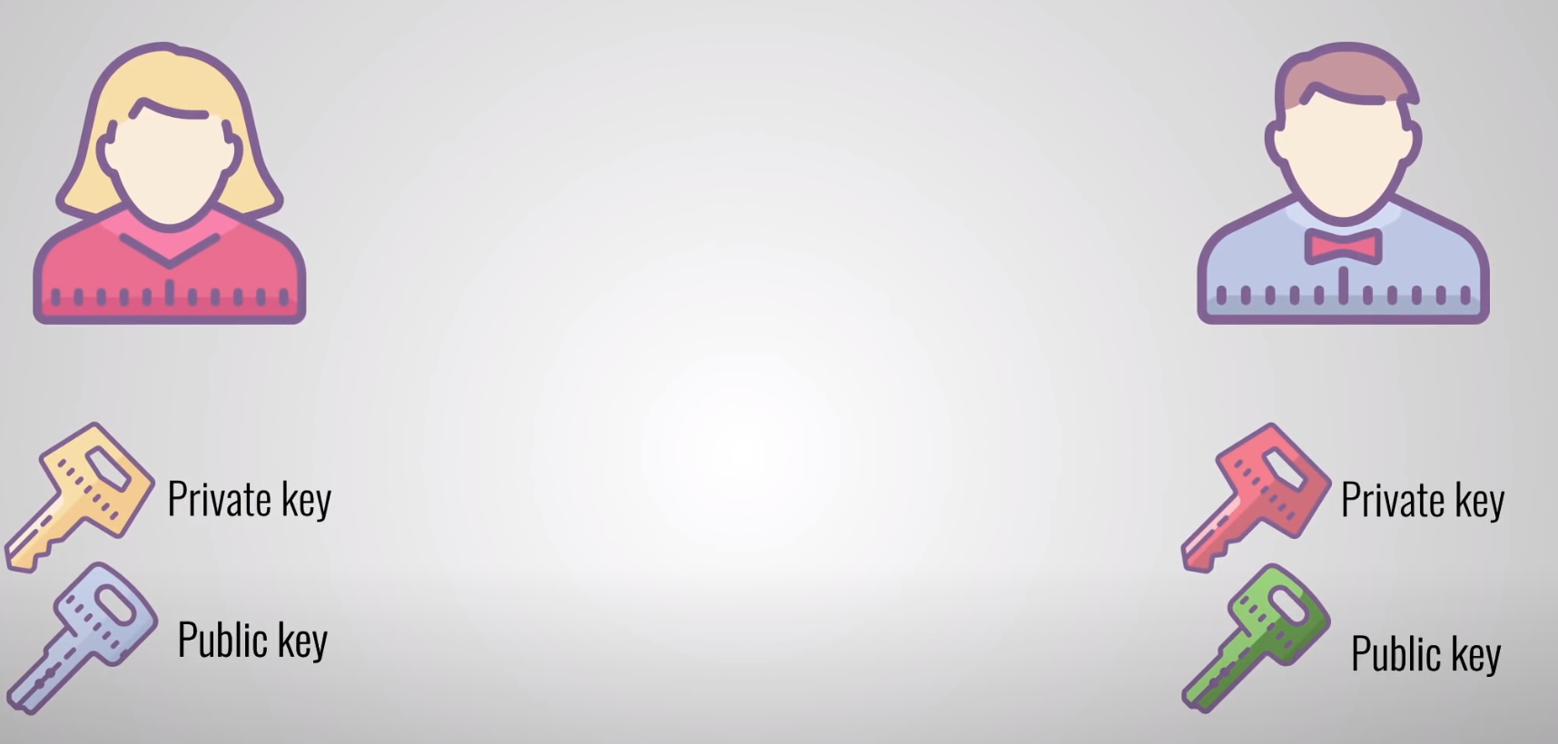
How Asymmetric Encryption Works
Key Pair Generation:
Step 1: Alice and Bob generate two keys: one is a public key, and the second is a private key.

Slide 29
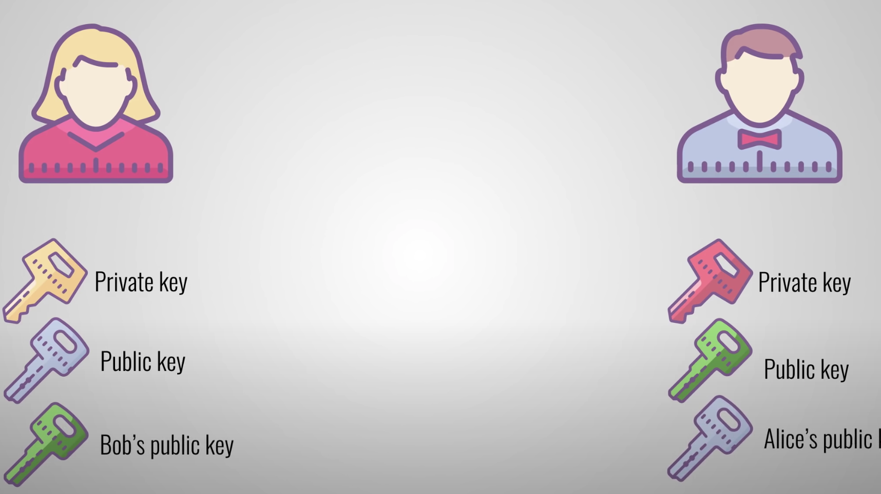
How Asymmetric Encryption Works
Share keys:
Step 2: Alice and Bob only start sharing public key and both keep private key secret .

Slide 30

How Asymmetric Encryption Works
Encryption: Step 3: Alice uses Bob public key to encrypt the plaintext message..

Slide 31
How Asymmetric Encryption Works
Encryption:
Step 4: The encryption process transforms the plaintext into ciphertext, which appears as a random jumble of characters.

Slide 32
How Asymmetric Encryption Works
Transmission:
Step 5: Alice transmits the ciphertext over an insecure communication channel (e.g., the internet).

Slide 33
How Asymmetric Encryption Works
Decryption:
Step 6: Bob receive the ciphertext.

Slide 34

How Asymmetric Encryption Works
Decryption:
Step 6: Bob use his private key to decrypt the ciphertext.

Slide 35
How Asymmetric Encryption Works
Decryption:
Step 7: The decryption process transforms the ciphertext back into the original plaintext message.

Slide 36
How Asymmetric Encryption Works
Let's do it in real life.

Slide 37
Common Asymmetric key algorithms
RSA (Rivest–Shamir–Adleman): Widely used for secure communication, digital signatures, and key exchange.

Slide 38
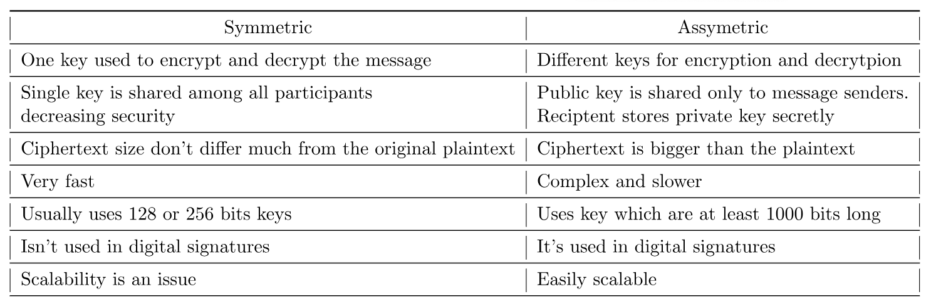
Difference between symmetric and asymmetric

Slide 39
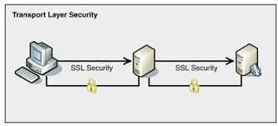
Cryptography Protocols
SSL/TLS (Secure Sockets Layer/Transport Layer Security):
Purpose: Secure communication over the internet by encrypting data transmitted between a client (e.g., web browser) and a server (e.g., web server).
Usage: Used for securing websites, online banking, email, and other online services.

Slide 40

Cryptography Protocols
SSH (Secure Shell):
Purpose: Secure remote access and file transfers over a network.
Usage: Typically used for remote administration of servers and secure file transfers.

Slide 41

Cryptography Protocols
PGP (Pretty Good Privacy) :
Purpose: Provides encryption and digital signatures for email and files.
Usage: Used for securing email communication and files by individuals and organizations.

Slide 42
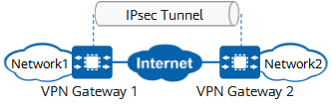
Cryptographic Protocols
IPsec (Internet Protocol Security):
Purpose: Provides security for IP-based communications by encrypting and authenticating data packets at the network layer.
Usage: Commonly used for creating virtual private networks (VPNs) and securing data transmission between networked devices.

Slide 43
Discussion
What is the primary purpose of encryption in everyday digital communication, and why is it important?
Take 10
Discuss with your team

Slide 44
Activity
Work in your CW1 assignment and focus in first point
Complete the following tasks:
Encryption (10% Marks)
Discuss the role of encryption in information security. Explain the difference between symmetric and asymmetric encryption algorithms. Provide examples of encryption technologies commonly used in securing data transmission and storage.
See the case study example and follow the steps to use it for risk assessment

Slide 45
What’s next on the agenda?
Break: 20 minutes
Lab Explanation
Lab Work

Slide 46


